Slide 1

SEAGRO
INTERNSHIP ASSESMENT

Slide 2

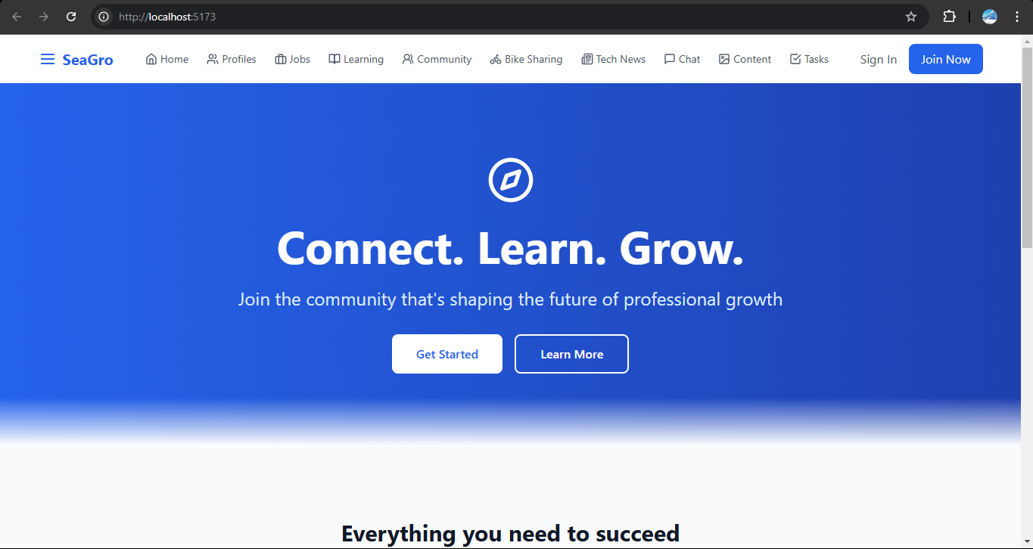
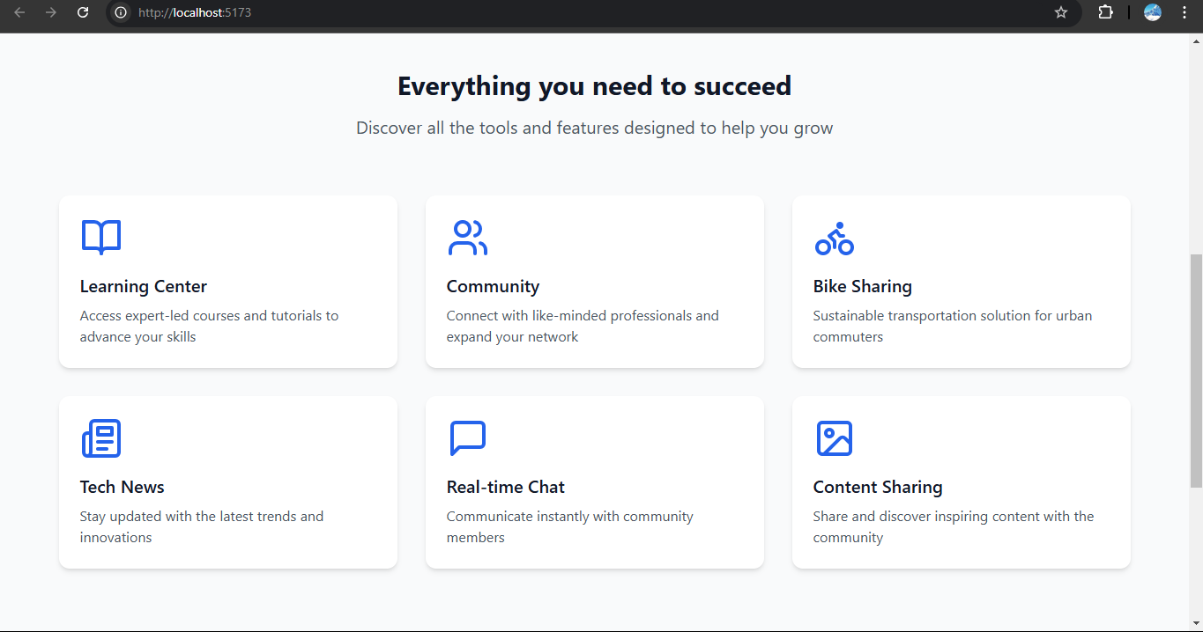
THE DESIGN

Slide 3

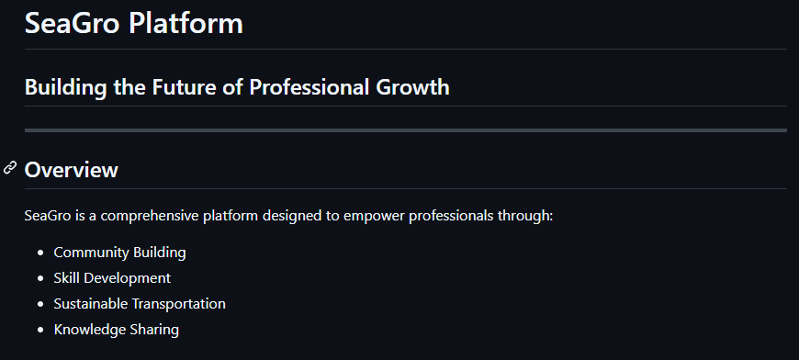
FROM GITHUB README
OVERVIEW

Slide 4






WHAT WE PROVIDE?
MARKETPLACE
EVERYTHING YOU NEED TO SUCCEED

Slide 5

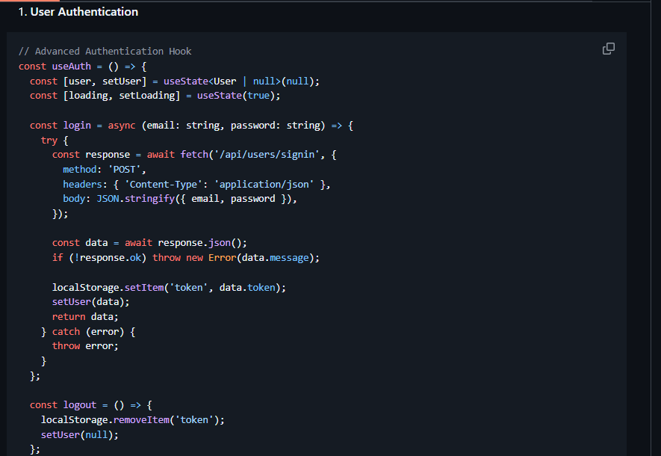
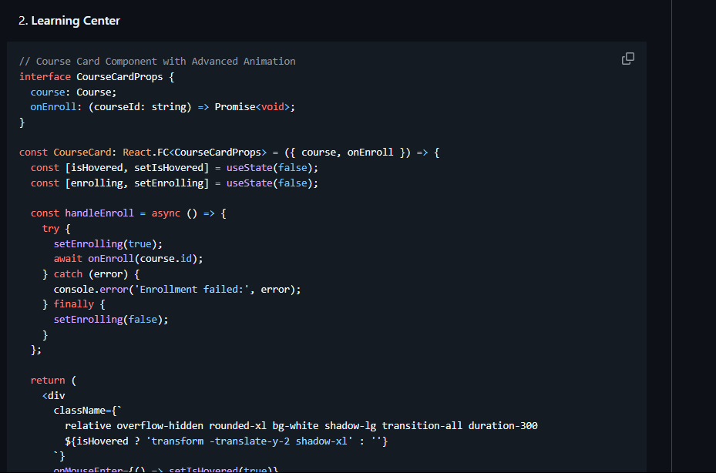
CODE
SNIPPETS

Slide 6
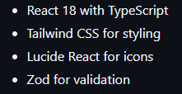
SO FAR
PROJECT TIMELINE
THE FRONTEND IS 80% COMPLETE
I have used the following technologies to create the minimalistic frontend :

Slide 7
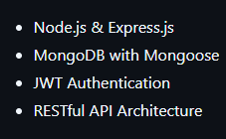
MISSION
AHEAD
SET UP BACKEND USING:
SEAGRO

Slide 8

LIVE LINKS
GITHUB REPO
PRODUCTION
Click here
Click here

Slide 9

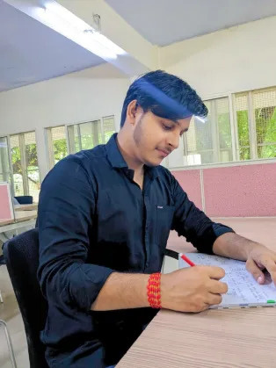
MY PROFILE
RITESH SHARMA
FULL-STACK DEVELOPER
GITHUB
RESUME
Click here
Click here
X
LINKEDIN
Click here
Click here

Slide 10


THANK YOU
CONTACT
+919343143604
riteshs29122002@gmail.com

